Slide 1
Data Governance Review for
[Spark – Team Mailbox Assistant]
[9 Jan 2026]
Instruction
​IT Lead of the Project or Project Owner to initiate DG review meeting if the project involves:​​
Critical Data Element (CDE): identification of new CDE; major changes of existing CDE (e.g., Ownership); or any CDE related initiatives. ​
Or any changes in Enterprise Data Model: An Enterprise Data Model (EDM) is a comprehensive, integrated set of descriptive representations of the data produced, stored, and or used by the entire or a major part of organisation. ​
Or any other data governance related item to consult Data Governance Team: data ownership, data classification, data privacy, metadata management, data sharing, etc.​
Template Version: Jun 2024

Slide 2
Table of Contents
Project Background & Overview
Roles & Responsibilities
Types of Data & Information Classification
Data Access
Data Usage
Metadata Management
Data Lineage

Slide 3
A. Project Background & Overview
Role | Name (Who) | POST
Project Owner | Calvin CH Yu | D (IT)(BSA)
IT Lead of the Project | Ray YC Tsoi | A(SYS)(IT)(AS2)2
Instruction
IT Lead of the Project should oversee the project and be accountable for the design, review process and development
Please provide high-level introduction and end-to-end solution diagram (if any)
Please describe the data lifecycle (creation, processing, storage, usage, sharing, disposal)
1. | There are 3 types of data that we store: 1. User configuration 2. Application logs 3. Categories The end-to-end solution works like this: The input is the email content for the specific team mailbox from CMMP, which are passed to the LLM provider (MaaS) with the prompt from the user, and the output is the summarization and categories generated by the LLM. The output of categories is synced with the CMMP using IMAP so the result is in sync for all the users connected to the team mailbox.
2. | (Next slide)

Slide 4
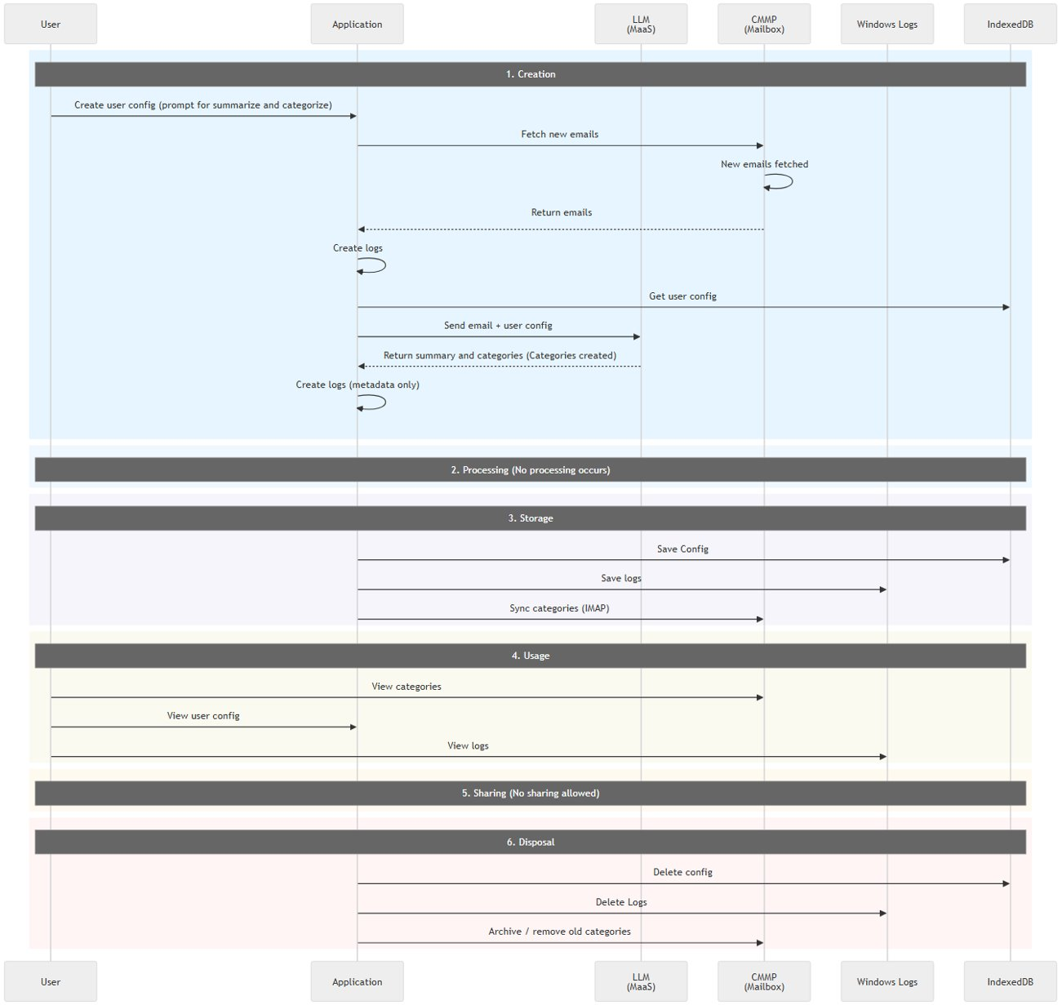
A. Project Background & Overview
Instruction
IT Lead of the Project should oversee the project and be accountable for the design, review process and development
Please provide high-level introduction and end-to-end solution diagram (if any)

Slide 5
(Continued)
Item | Content | Processing | Storage | Usage | Sharing | Retention period
User configuration | First 10 prompt history record ; description of mailbox folders | No processing, directly stored | IndexedDB (Browser) | Individual VD user | Not intended to be shared with anyone | (Until removal by user)
Application Log | User actions*: - Log in and log out (Mailbox and SARA) - Fetch email through IMAP - Create folders through IMAP - Move emails into folders through IMAP - Call the SARA API | No processing, directly stored | Windows application log | Audit Team | Not intended to be shared with anyone | 180 days
Categories | Categories name which become the folder name in Outlook | No processing | Sync with CMMP | All users connected to the specific team mailbox | N/A | (Until removal by user)

Slide 6
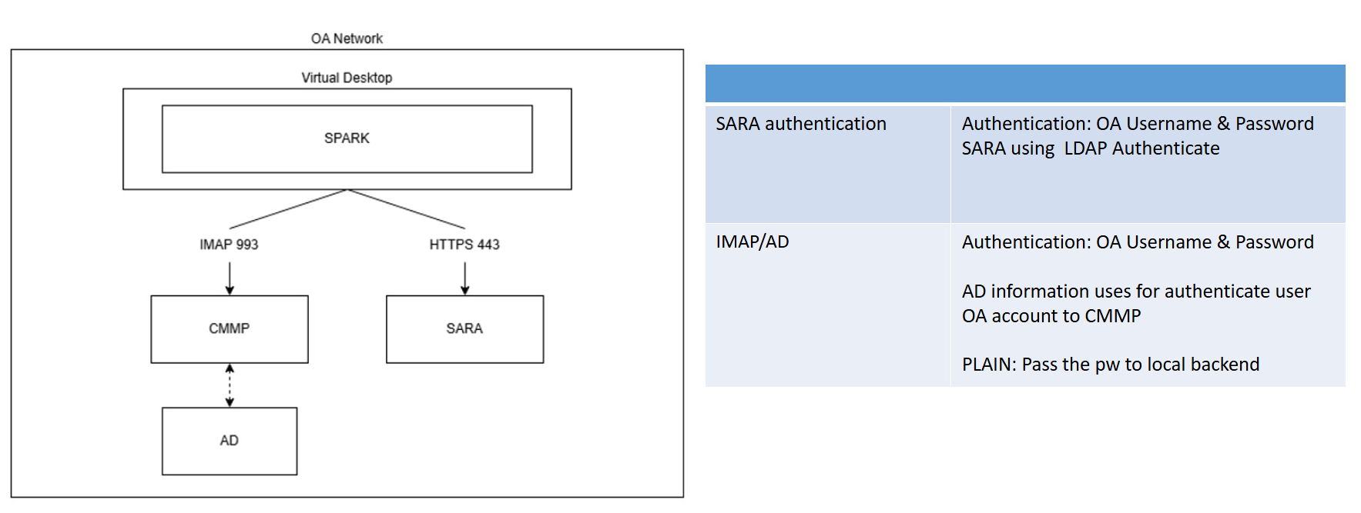
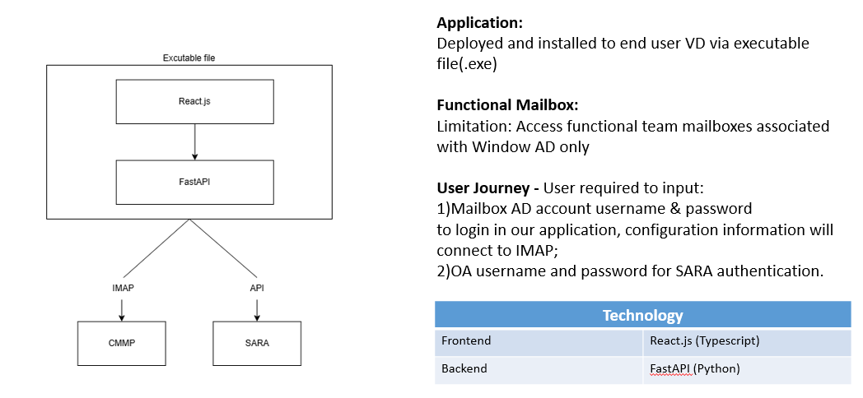
Application Architecture
Physical Architecture
Logical Architecture

Slide 7
B. Roles & Responsibilities
Please identify the roles involved in the project and the assignment of each role
  Please refer to the HKMA Data Policy (Section 5) for R&R definition
  Please refer to SOP 10b for identification of Data Owner and Data Steward
Instruction
If involved more than one Business Domain / CDE, please list out all corresponding Data Owner, Data Steward and Technical Steward.
Role | Assignment (POST) | Business Domain / Critical Data Element (CDE) | Responsibilities (Only highlight if any deviation or addition from responsibilities stated in SOP)
[Data Owner] *In general, Data Owner will be Division Head or above unless specified. | CIO | IT | N/A
[Data Steward] * Appointed by Data Owner – SME of the data domain; will be SM or below. | Calvin | BSA | N/A
[Technical Steward] * Appointed by System Owner; will be SM or below | Calvin | BSA | N/A

Slide 8
C. Types of Data & Information Classification
Instruction
All data should be classified.
Sensitive data must be located, so that security measures can be applied throughout data lifecycle to protect from data loss, damage and unauthorised access. Security measures will vary depending on security classification of the data concerned.
The data in this table must exist in the spreadsheet provided at F. Metadata Management page.
Only need to list out data:
with Personal Data
OR data classification is restricted or above (i.e., Restricted, Confidential, Secret, Top Secret) in this page.
Information classification - Please refer to SOP 8c
Definition of Personal Data - Please refer to PD(P)O for the details.
Name of the Dataset | Business Domain / Critical Data Element (CDE) | Information Classification | Has Personal Data? (Yes / No) | Encryption at rest? (Yes / No / Not applicable) (please provide justification if answered “No” or “Not Applicable”) | Encryption in transit? (Yes / No / Not applicable) (please provide justification if answered “No” or “Not Applicable”)
Application logs | IT | Restricted | No | No, since it does not store PII | No, since it does not store PII
User configuration | IT | Restricted | No | No, since it does not store PII | No, since it does not store PII
Categories | IT | Restricted | No | No, since it does not store PII | No, since it does not store PII

Slide 9






D. Data Access
Instruction
Role-based access control should be applied.
Data usage should be identified, reviewed and tracked relevant to the business process.
# | Question | Answers
1 | Please describe the access control applied on data | N/A since we are not a centralized system. The application runs locally on every users VD.
2 | Is Role-Based Access Control (RBAC) being enforced? *Please refer to SOP 6 Data Access | N/A, since the only user that can access the data
3 | What information is tracked in audit logs? | - Log in and log out (excluding username and password) - authentication logging (user login) is done by backend windows domain controller and CMMP. (In the security log of the server). - Fetch email via IMAP (excluding email contents) - Call the SARA API (excluding payload content) For below privileged user / AI actions, the log event should not contain any sensitive data. - Create folders through IMAP (excluding email contents and folder name) - Move emails into folders through IMAP (excluding email contents and folder name)
4 | How long will the audit logs be stored? | 180 days
Individuals
Grouped by Roles
Systems

Slide 10
E. Data Usage
Instruction
All relevant statutory, legal, regulatory and contractual requirements applicable to the operations of data in the HKMA and systems used to process the data shall be identified and documented.
Data Sharing Agreement refer to data usage restrictions set out in any agreement with vendor of Third Party Data or consent-based agreement.
# | Question | Yes / No / Not Applicable | Artefact/ Justification
1 | Are the compliance requirements identified and documented? (Including all relevant statutory, legal, regulatory and contractual requirements applicable to the operations of data in the HKMA and systems used to process the data ) | N/A | The application will not process or store any sensitive data.
2 | Is there any Data Sharing Agreement applied? * Please refer to SOP 9c | No | We are not using any 3rd party data
3 | Is the intended data lifecycle in compliant with the compliance requirements listed above? | N/A

Slide 11
F. Metadata Management
Instruction
Data in the HKMA must be defined and have clear Data Definitions across all teams/departments.
Business metadata are required on top of technical metadata
Mandatory business metadata:
Business Definition
Data Owner
Data Source
Information Classification
Is Personal Data?
# | Question | Yes / No / Not Applicable | Artefact
1 | Are the metadata clearly defined and documented? * Please refer to SOP 10 Metadata Management | Yes | Please fill in Metadata Template (*Sheet C) You may supplement artefact, e.g., data dictionary, if any

Slide 12
G. Data Lineage
Instruction
Data published externally/internally should be governed and tracked through the entire data flow of all relevant IT applications, from data capture to final submission
Data lineage must be defined/obtained to facilitate issue management, data usage review and system development.
# | Question | Answer
1 | Are the data being/ going to be published internally or externally? Please provide details | No
2 | Please specify data lineage of which part of the data flow is captured and documented, manually or captured by tools. If data lineage of any part of the data flow is missing, please justify. | No, we only move the data outside our application to SARA. SARA does not store the content of the requests.
3 | At what level the data lineage is captured and documented? (Column-level, Table-level or Entity-level, etc.) | N/A
4 | Please provide the data lineage by filling in below template * Minimum requirement is in Entity-level | N/A
5 | Is the data lineage (as described above) sufficient to facilitate issue management and usage review? Please provide justification. | Yes, since there is no data lineage.

Slide 13

Instructions
Instruction for DG Review process
Should you have any inquiries on Data Governance related topics, please feel free to contact us:
DO Data Governance Team
dgt@hkma.gov.hk

